Slide 1
Exam 2 Review

Slide 2
Topics for Exam 2
Topics | Reading
Heap and Heap Sort | 5.1-5.7
Binomial Heaps | 5.8
Binary search tree, Splay Trees | GT 3.1, 3.4
Disjoint Set | 5.9
Greedy Algorithms - Coin Change - Minimum Spanning Tree - Dijkstra’s algorithm - Knapsack - Scheduling | 6
Divide-and-Conquer - Mergesort and quicksort - Median - Closest pair | 7

Slide 3
Heaps
Know the definition
  What is the heap property?
Given a node, know how to calculate its parent and children
Know how percolate, sift-down, make heap, and heap sort work
  Can write and analyze these algorithms
  Given an example heap, demonstrate how these algorithms work
  Design a new similar heap related algorithm

Slide 4

Some important properties of heaps
Given a node T[i]
  It’s parent is T[i/2], if i>1.
  It’s left child is T[2*i], if 2*i<=n.
  It’s right child is T[2*i+1], if 2*i+1<=n.
The height of a heap containing n nodes is

Slide 5
Heap Algorithms and Efficiency
Class Heap {
int T[];
int n;
public void alterHeap(int i, int v); // O(lg n)
public void siftDown(int i); // O(lg n)
public void percolate(int i); // O(lg n)
public int findMax(); // Θ(1)
public int deleteMax(); // O(lg n)
public void insert(int v); // O(lg n)
public void makeHeap(); // O(n)
public void heapSort(); // O(nlogn)
}
Cost analysis for makeHeap() not required.

Slide 6
Binomial Heaps
Know the definition of Binomial Trees and Binomial Heaps
Understand the following algorithms
  (Can write and analyze these algorithms.
  Given an example binomial heap, demonstrate how these algorithms work.
  Design a new similar binomial heap related algorithm)
  Merge two equal size binomial trees
  Merge two binomial heaps
  findMax()
  deleteMax()
  Insert()

Slide 7
Merge two equal size binomial trees
BinomialTree mergeBinomialTrees(B1, B2){
// B1, B2 are the same size
if (B1.root().key > B2.root().key) {
B.copy(B1);
B.setChild(B1.rank(), B2);
B.setRank(B1.rank()+1);
} else {
// link in the other way
…
}
}
It takes a time in O(1).

Slide 8

Merge two binomial heaps
mergeBinomialHeaps(H1, H2)
{
while (simultaneously following the links in H1 and H2) {
if there are three rank i trees{
merge two of them and set it as carry-on;
add the remainder to H;
} else if there are two rank i trees {
merge the two trees;
set it as carry on;
} else if there is one rank i tree{
add it to H;
}
}
add the carry-on if exists to H.
}
Assume the result binomial heap contains n nodes. The
construction can be done in stages. Time in O(log n)

Slide 9
findMax()
Return the node pointed by the max pointer.

Slide 10
deleteMax()
deleteMax(H)
{
take the max binomial tree B out (H/B);
remove the root of B;
join the subtrees into a new binomial heap H2;
merge H/B and H2;
}
Cost: O(log n)

Slide 11
insert
insert(v, H)
{
make a 1 node binomial tree B0;
Build a binomial heap H0 that contains B0;
merge H0 and H;
}

Slide 12
Disjoint set structures
Know the definition
Given set[], know how to draw the sets in trees
Know how the following algorithms work
  find1() and merge1()
  find2() and merge2()
  find3() and merge3()

Slide 13
Representation 1: Θ(n²)
Use the smallest member of each set as label
Declare an array set[1..n] where set[i] is the label of object i.
Merge1(a,b)
{
i = min(a,b);
j = max(a,b);
for (k=1; k<=N; k++) {
if (set[k] == j)
set[k] = i;
}
}
find1(x)
{
return set[x];
}
Θ(1)
Θ(N)

Slide 14
Rooted tree: Θ(n²)
find2(x)
{
r = x;
while (set[r] != r)
r = set[r];
return r;
}
merge2(a, b)
{
if (a<b)
set[b] = a;
else
set[a] = b;
}
Θ(N) in worst case
Θ(1)

Slide 15
A new merge algorithm
find2(x)
{
r = x;
while (set[r] != r)
r = set[r];
return r;
}
merge3(a,b)
{
if (height(a) == height(b)) {
height(a) = height(a) + 1;
set[b] = a;
} else if (height(a) < height(b))
set[a] = b;
else
set[b] = a;
}
Θ(log N) in worst case
Θ(1)
Total operations: Θ(N + nlog N)

Slide 16
A further improvement
Squash the path when doing find(), so the next find() will be likely quicker (path compression).
  first pass to find the root
  second pass change the pointers along the path to the root and make them all point to the root
find3(x)
{
r = x;
while (set[r] <> r)
r = set[r];
i = x;
while (i <> r) {
j = set[i];
set[i] = r;
i = j;
}
return r;
}
Cost analysis
not required

Slide 17
Binary search tree
Know the definition
Know how search(), insert(), delete() work

Slide 18
Binary search tree
Definition:
  A binary tree,
  Where each internal node v stores an element e
  The left subtree of v are <= e
  The right subtree of v are >=e
Assume all external nodes are empty
The in-order traversal of binary search tree visits elements in non-decreasing order

Slide 19
Search A Binary Search Tree
Node binaryTreeSearch(Key k, Node v)
// Parameters: k, key to search
// v, the root of the subtree to search
// return a node when found match key
// otherwise, return an external node
{
if (v is an external node)
return v;
if (k == key(v))
return v;
else if (k < key(v))
binaryTreeSearch(k, v.leftChild());
else
binaryTreeSearch(k, v.rightChild());
}
Cost? Best case? Worst Case?

Slide 20
Insertion in a Binary Search Tree
To insert element e with key k.
Let w be the node returned by binaryTreeSearch()
  If w is an external node, replace it by an internal node with the key k and element e.
  If w is an internal node, continue to search its right subtree (or left subtree) until find an external node. Then apply case 1.

Slide 21
Removal in a Binary Search Tree
To remove a node with key k, Let w be the node returned by binaryTreeSearch(k, root)
  If w is an external node, done!
  If w is an internal node
    One of w’s children is an external node, z. Remove w and z, and replace w by z’s sibling
    Both children of node w are internal nodes
      Find internal node y that follows w in an inorder traversal
      Replace w’s content by y’s.
      Remove y using case (a).

Slide 22
Splay Trees
Know the splaying steps after insertion, deletion and search

Slide 23
Splay Trees
Apply splaying after every access to keep the search tree balanced in an amortized sense
Splaying
  Splay x by moving x to the root through a sequence of restructurings
  One specific operation depends on the relative positions of x, its parent y, and its grandparent z
    Zig-Zig
    Zig-Zag
    Zig

Slide 24
Splay x: zig-zig
The node x and its parent y are both left or right children
x
z
30
10
y
y
20
20
z
T₄
x
T₁
30
10
T₂
T₃
T₃
T₄
T₁
T₂

Slide 25
Splay x: zig-zag
One of x and y is a left child and the other is a right child.
z
10
y
x
20
30
z
y
T₁
T₄
10
30
20
x
T₁
T₂
T₃
T₄
T₂
T₃

Slide 26
Splay x: zig
The node x does not have a grandparent (or the grandparent is
not of our concern)
y
10
x
x
20
20
y
T₁
10
T₂
T₃
T₃
T₁
T₂

Slide 27
When to Splay
When searching for key k, splay the found internal node or the parent of the external node when search fails
When inserting a key k, splay the newly created internal node
When deleting a key k, splay the parent of the node that gets removed (See slide: Removal in a Binary Search Tree).

Slide 28
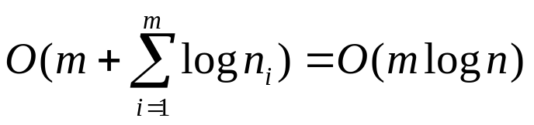
Properties of Splay Trees
Linear depth when inserting keys in increasing order
  What’s the worst case cost for search, insertion, and deletion respectively?
Consider a sequence of m operations on a splay tree, each a search, insertion, or deletion, starting from an empty tree with zero keys, also let n_{i} be the number of keys in the tree after operation i, and n be the total number of insertions. The total running time for performing the sequence of operations is

Slide 29
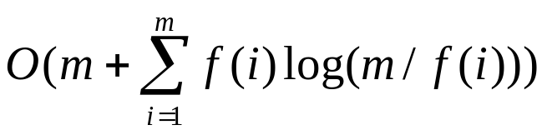
Properties of Splay Trees
Consider a sequence of m operations on a splay tree, each a search, insertion, or deletion, starting from an empty tree with zero keys, also let f(i) be the number of times the item i is accessed in the splay tree, that is, its frequency, and let n be total number of items. Assuming that each item is accessed at least once, then the total running time for performing the sequence of operations is

Slide 30
Greedy algorithms
Know the paradigm
  Template of a greedy algorithm
  Be able to design a greedy algorithm
Understand the following algorithms
  Coin change
  MST (Prim’s algorithm and Kruscal’s algorithm)
  Dijkstra’s algorithm ( single source shortest path)
  Knapsack
  Scheduling for shortest total response time

Slide 31

General characteristics of greedy algorithms
makeChange(int n)
{
C = a set of available coins;
S=; // chosen coins
s=0;
while (C !=  && s != n) {
x = a coin in C with the largest value
such that s+x<=n;
if no such x exists
return “no solution found”;
else {
C = C \ {x};
S = S {x};
s = s+x;
}
}
}
greedy(SET C)
{
// C is set of candidates
S= ; // S is a partial solution
while (C != ) {
x = select(C);
if (feasible(S {x}))
S = S {x};
if (solution(S))
return S;
}
return “no solutions”;
}
objective() function is implicit

Slide 32

Kruskal’s algorithm -- efficiency
Kruskal(Graph G) // G=<N,A>
{
sort A by increasing weight;
n = #nodes in N;
T = ;
make n initial sets, each contains a node in N;
do { // for all sorted edges
e = <u,v>; // shortest edge not yet considered
uComponent = find(u);
vComponent = find(v);
if (uComponent != vComponent) {
merge(uComponent, vComponent);
T = T  {e};
}
} while (!(T contains n-1 edges))
return T;
}
Θ(alog a)
called at most a times each
called n-1 times
Θ(2a α(2a, n))

Slide 33
Prim’s algorithm
Prim(int L[][])
{
T = ;
for (i=2; i<=n; i++) {
nearest[i] = 1;
mindist[i] = L[i,1];
}
for (i=2; i<n; i++) {
min = ;
for (j=2; j<=n; j++) {
if (mindist[j] >=0 && mindist < min) {
min = mindist[j];
k = j;
}
}
T = T  <nearest[k], k>;
mindist[k] = -1;
for (j=2; j<=n; j++) {
if (L[j,k] < mindist[j]) {
mindist[j] =L[j,k];
nearest[j] = k;
}
}
}
}
Θ(n)
Θ(n²)

Slide 34
Dijkstra’s algorithm
Dijkstra(Weight L[][])
{
/* initialization */
C = {i | 2 <= i <= n}; // S = {1}
for (i=2; i<=n; i++) {
D[i] = L[1,i];
P[i] = 1;
}
for (i=1; i<=n-2; i++) { // repeat n-2 times
v = some element of C minimizing D[v];
C = C – {v}; // S = S  {v}
for (each w ) {
if ( D[v]+L[v,w] < D[w]) {
D[w] = D[v]+L[v,w];
P[w] = v;
}
}
}
C: candidate set
S : partial solution set
L[i][j]: weight of edge <i,j>
D[i]: length of the special
path for the source to
node i.
P[i]: the previous node of
i along its shortest
path.

Slide 35
Analysis of Dijkstra’s algorithm: using heap
a: #edges
n: #nodes
Dijkstra(Weight L[][])
{
/* initialization */
C = {i | 2 <= i <= n}; // S = {1}
for (i=2; i<=n; i++) {
D[i] = L[1,i];
P[i] = 1;
}
buildHeap(D); // inverted heap
for (i=1; i<=n-2; i++) { // repeat n-2 times
v = findMin(D[]);
deleteMin(v); //C = C – {v}; S = S  {v}
for (each w ) {
if ( D[v]+L[v,w] < D[w]) {
D[w] = D[v]+L[v,w];
percolate(v);
P[w] = v;
}
}
}
Θ(n)
Θ(n)
Θ(1)
O(log n)
At most a times if use
adjacent list
O(log n)
Total: O((a+n) log n)
=O(a log n)

Slide 36
The knapsack problem
Given
  n objects numbered from 1 to n. Object i has a positive weight w_{i} and a positive value v_{i}
  a knapsack that can carry a weight not exceeding W
Problem
  Fill the knapsack in a way that maximize the value of the included objects, while respecting the capacity constraints
  In this version, we assume that the objects can be broken into small pieces

Slide 37
A greedy algorithm
Knapsack(w[], v[], W)
{
for (i=1; i<=n; i++)
x[i] =0;
weight = 0;
while (weight < W) {
i = select the best remaining object;
if (weight + w[i] < W)
x[i] = 1;
else
x[i] = (W-weight)/w[i];
}
return x;
}
The key is
which object
to select

Slide 38
Scheduling
Minimizing time in the system
  Know the problem
  Know the proof
  Know the algorithm
Scheduling with deadlines ( not required)

Slide 39
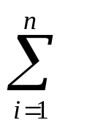
Minimizing time in the system
Assume we submit n jobs into a system at the same time.
  The service time of job i, t_{i}, know in advance
Problem
  Design an algorithm that minimizing the average response time
  This is equivalent to
    Minimizing the total response time
    T = (response time of job j)

Slide 40
A greedy algorithm
Algorithm
  Sort the jobs by their service times
  Repeat
    Serve the job with minimal service time among the remaining jobs
Analysis
  Step 1: O(n log n)
  Step 2: Θ(n)
  Total: O(n log n)

Slide 41
Optimality of the greedy scheduling algorithm
Theorem 6.6.1. The greedy algorithm is optimal
1..a-1
a
a+1..b-1
b
b+1..n
P
exchange a and b
P’
1..a-1
b
a+1..b-1
a
b+1..n
Compares schedules P and P’, job a at P’ leaves at the same time
as job b in P. Jobs b and a+1 to b-1 in P’ leaves earlier then the corresponding
jobs in P.

Slide 42
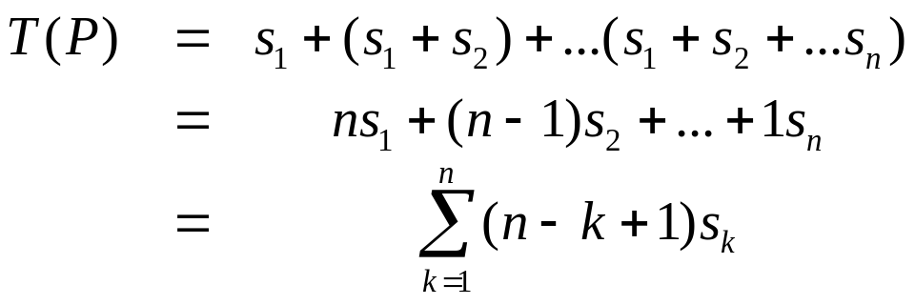
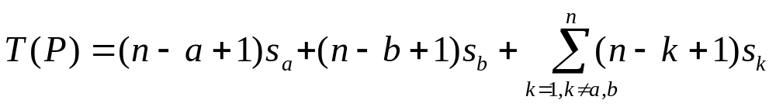
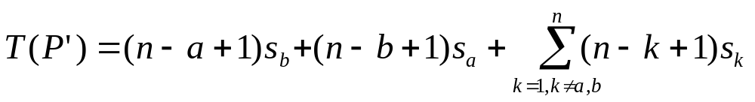
Optimality of the greedy scheduling algorithm

Slide 43
Divide and Conquer
Given a problem, know how to design a D&C algorithm
Know how to analyze a D&C algorithm
  You need to remember the simple version of the Master Theorem.
Know the following algorithms
  Merge sort
  Quick sort
  Find median
  Closest pair

Slide 44
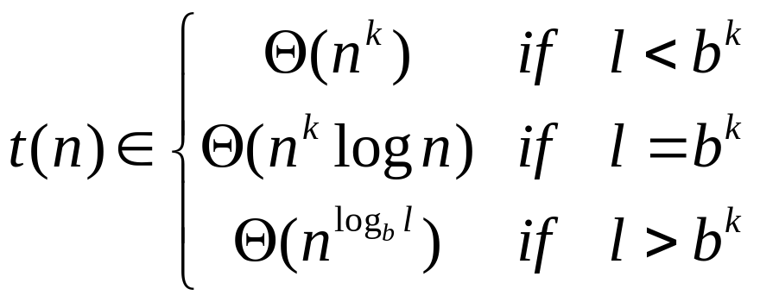
Running-time analysis
Assume that the l sub-instances have roughly the same size n/b for some constant b
Let g(n) be the time required by DC on instances of size n, excluding the times need for the recursive calls. We have
  t(n) = l·t(n/b) + g(n)
If g(n)  Θ(n^{k}) for an integer k, we have

Slide 45
Merge sort
mergeSort(int T[n])
{
if (n is sufficiently small)
insertionSort(T);
else {
int U[n/2], V[(n+1)/2];
copy T[1..n/2] to U[1..n/2];
copy T[n/2+1,..,n] to V[1.., (n+1)/2];
mergeSort(U[n/2]);
mergeSort(V[(n+1)/2);
merge(U,V,T);
}
}

Slide 46
Merge two sorted arrays
Merge(U[m], V[n], T[m+n])
// merge sorted arrays U and V into T
{
u = 0; // cursor for U
v = 0; // cursor for V
U[m] = V[n] = +; // sentinels
for (t=0; t<m+n; t++) { // t is cursor for T
if (U[u] < V[v]) {
T[t] = U[u];
u++;
} else {
T[t] = V[v];
v++;
}
}
}
What to do if we do not use the two sentinels?

Slide 47
Quick Sort
Choose an element from the array to be sorted as a pivot
Partition the array on either side of the pivot such that those no smaller than the pivot are to its right and those no greater are to its left
Recursive calls on both sides

Slide 48
The algorithm
quickSort(T, i, j)
{
l = pivot(T, i, j); // l is the position of the pivot at end
if (i<l-1)
quickSort(T, i, l-1);
if (l+1<j)
quickSort(T, l+1, j);
}

Slide 49
Pivot I
int pivot(T, i, j)
{
// choose T[i] as the pivot
p = T[i];
l = i; // left cursor
r = j+1; // right cursor
do {
l++;
} while (T[l]<=p and l < r)
do {
r--;
} while (T[r] > p);
while (l<r) {
swap(T[l], T[r]);
do {
l++;
} while (T[l] <= p);
do {
r--;
} while (T[r] > p)
}
swap(T[i], T[r]);
return r;
}
T[i] is at the bound after the algorithm

Slide 50
Analysis
Worst case: the array is sorted, Ω(n²)
Best case
  T(n) = 2T(n/2) + Θ(n), T(n)  Θ(n log n)
Average case ( not required)

Slide 51
Selection using pseudomedian
selection(T[1..n], s)
{
l = 1; r = n;
while (true) {
x = pseudomedian(T[l..r]);
p = pivot(T[l..r], x);
if (s<p) r = p-1;
else if (s>p) l = p+1;
else return p;
}
}
pseudomedian(T[1..n])
{
if (n <= 5)
return adhocmedian(T);
z = n/5;
for (i=1; i<=z; i++)
Z[i] = adhocmedian(T[5i-4..5i]);
return selection(Z, z/2);
}
We assume the elements are distinct.
You need to know the time complexity of this algorithm

Slide 52

Closest Pair
Problem
  Given n points on a two-dimension space, find the closest pair
A simple algorithm
  Calculate the distance for all possible pairs, find a smallest one
    Total pairs
    Cost: (n²)
A better algorithm
  Divide-and-conquer

Slide 53
Algorithm
double closestPair(Points p)
{
n = p.size();
mergeSort(p); // by x-coordinate
return recursiveClosestPair(p, 1, n)
}
double recursiveClosestPair(p, i, j)
{
if ( j-i < 3) {
return adhocClosest(p, i, j);
sort p[i..j] by y-coordinate;
}
k = (i+j)/2;
deltaL = recursiveClosestPair(p, i, k);
deltaR = recursiveClosestPair(p, k+1, j);
delta = min(deltaL, deltaR);
return findClosestInStrip(p, i, j, delta);
}
Note: p[i..j] are sorted by x-coordinate before getting in recursiveCloestPair();
sorted by y-coordinate after it returns;

Slide 54
findClosestInStrip
findClosestInStrip(p, i, j, delta)
{
k = (i+j)/2; l = p[k].x;
// p[i..k] sorted by y-coordinate
// p[k+1..j] sorted by y-coordinate
merge(p, i, k, j); // p[i..j] sorted by y-coordinate
t = 0;
for (k=i; k<=j; k++) {
if (p[k].x > l – delta
&& p[k].x < l+delta) // in the strip
v[++t] = p[k];
}
for (k=1; k<t; k++) {
for (s=k+1; s<=min(t, k+7); s++)
delta = min(delta, dist(v[k], v[s]));
}
return delta
}
m = j-i+1
(m)
(m)
Cost?
O(m)
Total: (m)

